Slide 1


Goal-oriented Workflow using Rstudio
Roxanne beauclair, Phd candidate, mph, ma
icrh, Ghent university
Sacema, stellenbosch university

Slide 2
What is ‘workflow’?
Deciding:
Where to store data?
How to refer to files in a script?
How to run scripts?
How to produce and collect report results?

Slide 3
Goals of your workflow
Transparency: organizes the components of a project logically, making it easy for other observers to understand how everything fits together
Maintainability: facilitates easy modification and adaptation of the project.
Modularity: Discrete tasks are separated into components (scripts), so it is clear where modifications need to be made.
Portability: Makes it easy to move the project to another system or hand over to another person
Reproduciblity: You and others should be able to reproduce the results
Efficiency: The workflow should save you time buy making it easier to debut, and automating as much of the process as possible

Slide 4
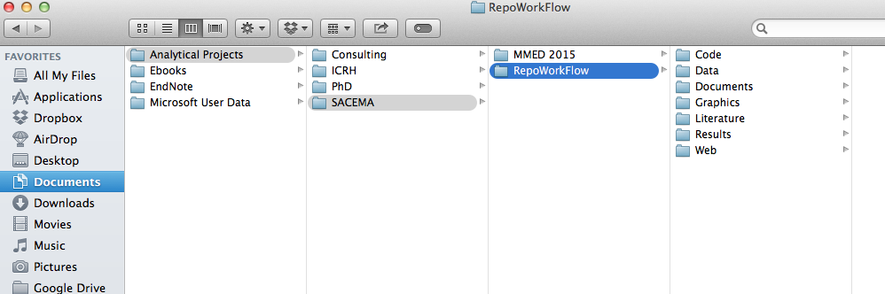
Organize your project
Good directory structure
Store all project-related files in one folder on hard-drive
Sub-directories for different aspects of the project

Slide 5
Directory structure in more detail
/Data
/Raw data
/Cleaned data
/Code
/Scripts
/Rmarkdown
/Do files
/Graphics
Saved plots as PNG or PDF
/Results
Html reports
Latex for word documents with outputs of data aggregation
/Documents
/Manusctipts
/Presentation Slides
/Literature
Key papers relevant to this particular project
/Web
Holds content for web site
Read-only
Modifiable,
Can be easily re-generated with code

Slide 6
/Code Folder
/Code
/Scripts
Importing raw data
Cleaning/fixing data
Exclusions
Any other transformations of dataset
Creating new variables
Imputation for missing data
Analysis
Functions
Tables and figures for final manuscript
Transparency

Slide 7
Version Control
Multiple people can work on one project, simultaneously without getting 'conflicted copies’
Access to historical versions of the file before different edits were made
Undo specific edits without loosing all work that has been done previously
At any point in time you can see who made what edits and when
Maintainability

Slide 8
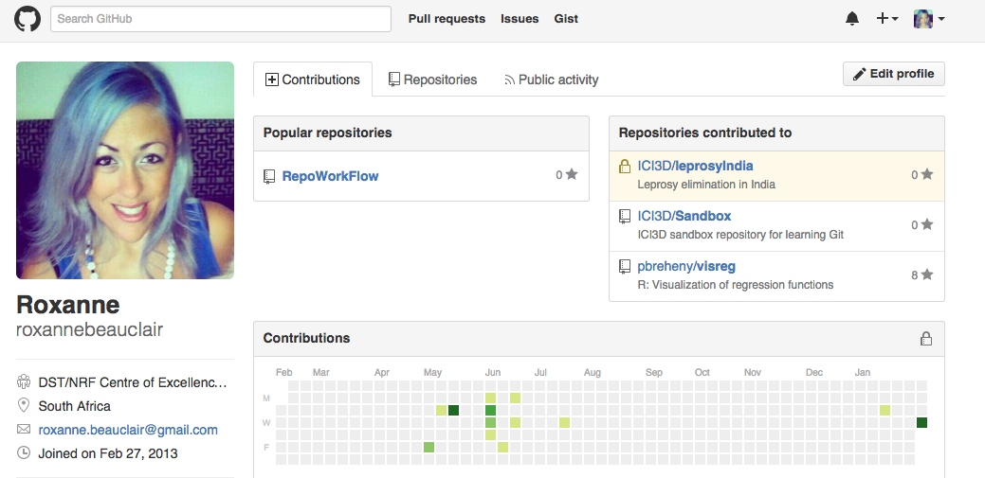
What is Git?
Git is an open source version control system that offers source code management
GitHub is a web-based Git repository hosting service

Slide 9
Basic Git Commands Chart
Web Interface
Repository
(On GitHub)
Clone
Pull
Commit
Local Repository
Push

Slide 10
Directions for Adding Git to the Workflow
1. Make sure your folder directory is set up in an organized way
2. Set up GitHub account (https://github.com), including your profile
3. Download and install platform-specific versions of a Git client app
I use SmartGit
Works on Linux, Windows, and Mac OS’s
User friendly
This will be used to push and pull files between the local repository and GitHub
4. Configure Git with global commands in your terminal.
git config --global user.name “your GitHub account name”
git config --global user.email “email address registered with GitHub”

Slide 11
Directions continued
5. Open Rstudio and set the path for the Git executable
Tools > Global Options > Git/SVN
It should auto-populate the location, then click ‘Ok’.
6. Restart Rstudio
7. Go back to GitHub and create a new repository
8. Go back to Rstudio and create a new project
Create project > Version Control > Add URL created by GitHub and select the location of the local subdirectory you want to use
I used my Code/Scripts local directory
9. Now do some work in Rstudio, create and save files in our local directory which is now linked to GitHub.
10. Go to your local git client, view modified files, commit and push them to GitHub.

Slide 12
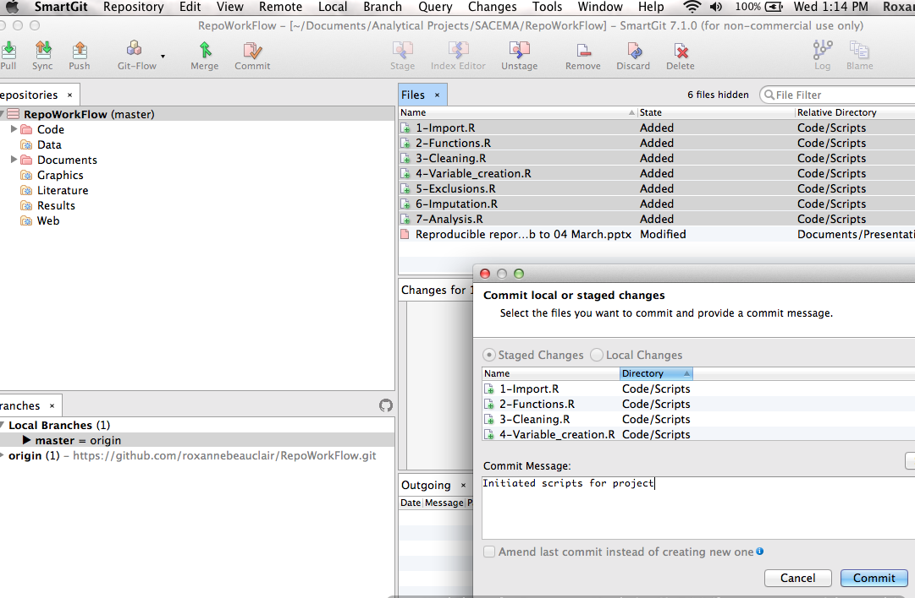

Slide 13
Helpful websites for this process
http://www.molecularecologist.com/2013/11/using-github-with-r-and-rstudio/
https://support.rstudio.com/hc/en-us/articles/200532077-Version-Control-with-Git-and-SVN
How to use SmartGit (https://www.youtube.com/watch?v=gB8OmhRJ0D8)

Slide 14
Good Style
Rule of transparency
“Good coding style is lke using correct punctuation. You can manage without it, but it sure makes things easier to read.”
—Hadley Wickham

Slide 15
Indentation and line lengths
Limit code to 80 characters per line
If you run out of room, good idea to put some of that code in a separate function or object
When indenting, use 2 spaces
Never use tabs
Exception: when function definition runs over several lines
long_function_name <- function(a = "a long argument",
b = "another argument",
c = "another long argument") {
# As usual code is indented by two spaces.
}

Slide 16
Spacing
Place spaces around all infix operators (=, +, -, <-, etc.). The same rule applies when using = in function calls. Always put a space after a comma, and never before (just like in regular English).
# Good
average <- mean(feet / 12 + inches, na.rm = TRUE)
# Bad
average<-mean(feet/12+inches,na.rm=TRUE)
There’s a small exception to this rule: :, :: and ::: don’t need spaces around them.
# Good
x <- 1:10
base::get
# Bad
x <- 1 : 10
base :: get
Place a space before left parentheses, except in a function call.
# Good
if (debug) do(x)
plot(x, y)
# Bad
if(debug)do(x)
plot (x, y)
Extra spacing (i.e., more than one space in a row) is ok if it improves alignment of equal signs or assignments (<-).
list(
total = a + b + c,
mean = (a + b + c) / n
)
Do not place spaces around code in parentheses or square brackets (unless there’s a comma, in which case see above).
# Good
if (debug) do(x)
diamonds[5, ]
# Bad
if ( debug ) do(x) # No spaces around debug
x[1,] # Needs a space after the comma
x[1 ,] # Space goes after comma not before

Slide 17
Curly braces
An opening curly brace should never go on its own line and should always be followed by a new line. A closing curly brace should always go on its own line, unless it’s followed by else.
Always indent the code inside curly braces.
# Good
if (y < 0 && debug) {
message("Y is negative")
}
if (y == 0) {
log(x)
} else {
y ^ x
}
# Bad
if (y < 0 && debug)
message("Y is negative")
if (y == 0) {
log(x)
}
else {
y ^ x
}
It’s ok to leave very short statements on the same line:
if (y < 0 && debug) message("Y is negative")

Slide 18
Conventions for naming files
File names should be meaningful and end in .R.
# Good
fit-models.R
utility-functions.R
# Bad
foo.r
stuff.r
If files need to be run in sequence, prefix them with numbers:
0-download.R
1-parse.R
2-explore.R

Slide 19
Conventions for naming variables
Variable and function names should be lowercase. Use an underscore (_) to separate words within a name. Generally, variable names should be nouns and function names should be verbs. Strive for names that are concise and meaningful (this is not easy!).
# Good
day_one
day_1
# Bad
first_day_of_the_month
DayOne
dayone
djm1

Slide 20
Conventions for naming functions
Where possible, avoid using names of existing functions and variables. This will cause confusion for the readers of your code.
# Bad
T <- FALSE
c <- 10
mean <- function(x) sum(x)

Slide 21
A note on data cleaning
Labelling all variables in your ‘clean dataset’ is very important (requires library memisc)!
description() : short description of the variable, always
wording() : wording of the question, if necessary
labels(): for values of a factor variable
Pro-tip: Label the variables exactly how you would want them to appear in a table for publication. This will save you time later when you automate your reports.

Slide 22
Layout and ordering of code
Rule of Modularity
Rule of Composition
Copyright statement comment
Author comment
File description comment, including purpose of program, inputs, and outputs
Function definitions
source( ) and library( ) statements
If it is a specialty package remind yourself which functions you are going to use in case you don’t have that package later, or decided you don’t need to use that function later.
Function definitions
Executed statements

Slide 23
Comments at the beginning of each file

Slide 24
Comments at the beginning of each function

Slide 25
Types of documents you can produce
Interactive interfaces between models and results
Shiny
Dynamic reports
Knitr = runs chunks of R code and appends results to parallel document
Pandoc = converts the program to new format
Html
PDF
Word
PDF slide show
Sweave
LaTeX
LyX

Slide 26
RMarkdown

Slide 27
YAML

Slide 28
References
http://www.kirchkamp.de/oekonometrie/pdf/wf-screen2.pdf
http://nicercode.github.io/blog/2013-04-05-projects/
http://journals.plos.org/ploscompbiol/article?id=10.1371/journal.pcbi.1000424
http://www.carlboettiger.info/2012/05/06/research-workflow.html
http://adv-r.had.co.nz/Introduction.html

